Slide 1
Lecture 12: Minimization of DFA
Agenda:
DFA Minimization Rules
Example of DFA Minimization
Presented by
Prof. Vaibhav Narayan Chunekar
K. J. Somaiya College of Engineering, Vidyavihar, Mumbai

Slide 2
Minimized DFA
Minimization of DFA is required to obtain the minimal version of DFA which consist of the minimum numbers of state possible.
DFA 5 States → 4 states by merging any two state without changing the meaning of DFA
When to merge two states?
➔ Equivalent States

Slide 3
Methods of DFA Minimization
State Equivalence Method
My Hill Nerode Theorem( Table Filling Method)

Slide 4
State Equivalence Method

Slide 5
Minimization DFA Rules:
When we say that two states are equivalent?
Two states let it be ‘A’ and ‘B’ are said to be equivalent if –
δ( A,x)→ F and δ(B,x)→ F
δ( A,x)≠ F and δ(B,x) ≠ F
where x is input string
If |x|= 0 then A and B are said to be 0 equivalent.
If |x|= 1 then A and B are said to be 1 equivalent.
If |x|= 2 then A and B are said to be 2 equivalent.
......
If |x|= n then A and B are said to be n equivalent.

Slide 6
DFA Minimization Rules:
For reducing equivalent state to a single state one should follow the following rules:
We can replace one non final state by its equivalent non final state only
We can replace one final state with its equivalent final state only
We cannot delete initial state.
We cannot replace one final state by its non final state or non final state by final state
Replace state A by state B meaning deleting all entries related to state A from transition table. Whenever we find A we replace with B.
We repeat the above steps until equivalence states are found. After getting two consecutive rows of equivalent state we stop the process.

Slide 7
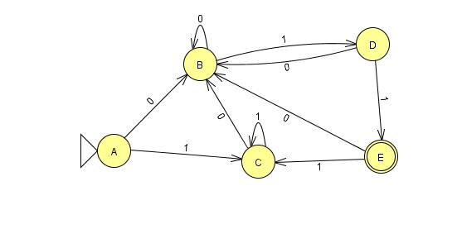
Example 1: Minimized the following DFA using Method 1.
Q Σ | 0 | 1
→A | B | C
B | B | D
C | B | C
D | B | E
* E | B | C

Slide 8
State Equivalence Method
0 equivalence : { A,B,C,D}{E}
1 equivalence : { A,B,C} {D}{E}
2 equivalence : { A,C} {B} {D}{E}
3 equivalence : { A,C} {B} {D}{E}
Stopping Condition: When two rows are consecutively giving same result then end the process.
Q Σ | 0 | 1
→A | B | C
B | B | D
C | B | C
D | B | E
* E | B | C

Slide 9
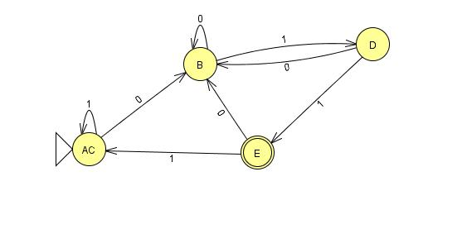
Minimized DFA:
Q Σ | 0 | 1
→A C | B | C
B | B | D
C | B | C
D | B | E
* E | B | C
Q Σ | 0 | 1
→AC | B | AC
B | B | D
D | B | E
* E | B | AC

Slide 10
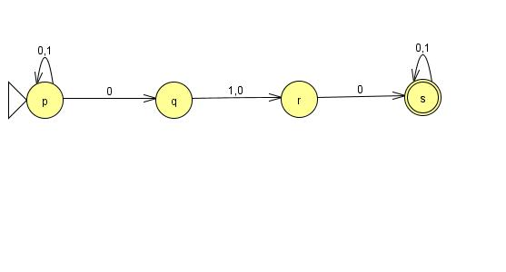
Example 2 : w ∈{0,1}*| w accept the string 000 or 010. Convert this language to NFA then DFA and follows with minimized DFA
NFA:
Q Σ | 0 | 1
→p | p,q | p
q | r | r
r | s | -
*s | s | s

Slide 11
Power Set 2 ^{Q}
Q’= {p,q,r,s,pq,pr,ps,qr,qs,rs,pqr,pqs,prs,qrs,pqrs}
F’= { s,ps,qs,rs,pqs,prs,qrs,pqrs}
δ ‘(p,0)= pq, δ ‘(p,1)= p; δ ‘(q,0)= r , δ ‘(q,1)= r;...........
δ ‘(pqr,0)={δ (p,0) U δ (q,0) δ (r,0) }={ { pq} U{r}U {s}} ={ pqrs}
indicate Start state
* Indicate Final State
According to this final state transition table are as follows:

Slide 12
State Transition Table
Rename State | Q Σ | Rename State 0 | Rename State 1
1 | →p | p,q(5) | P(1)
2 | q | r(3) | R(3)
3 | r | *S(4) | -
4 | *s | *S(4) | *S(4)
5 | pq | Pqr(11) | Pr(6)
6 | pr | *Pqs(12) | P(1)
7 | *ps | *Pqs(12) | *Ps(7)
8 | qr | *Rs(10) | R(3)
9 | *qs | *Rs(10) | *Rs(10)
10 | *rs | *S(4) | *S(4)
11 | Pqr | *Pqrs(15) | Pr(6)
12 | *pqs | *Pqrs(15) | *Prs(13)
13 | *prs | *Pqs(12) | *Ps(7)
14 | *qrs | *Rs(10) | *Rs(10)
15 | *pqrs | *Pqrs(15) | *Prs(13)

Slide 13
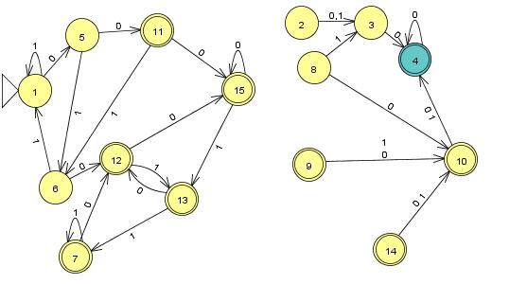
DFA(15 states):

Slide 14
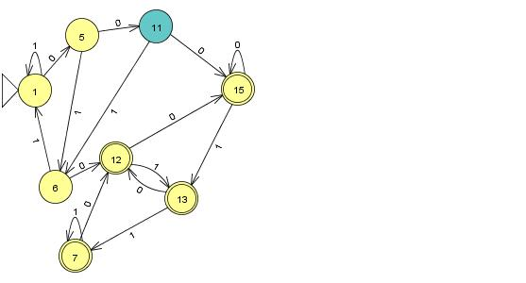
Remove the Unreachable State

Slide 15
0 equivalence
Q={1,5,6,7,11,12,13,15 }
Set of Non Final State:
{1,5,6,11}
Set of final State:
{7,12,13,15,}

Slide 16
Minimized State Transition table
Q Σ | 0 | 1
1 | 5 | 1
5 | 11 | 6
6 | *12 | 1
*7 | *12 | *7
11 | *15 | 6
*12 | *15 | *13
*13 | *12 | *7
*15 | *15 | *13

Slide 17
1 equivalence
{1,5,6,11}
={ 1,5} {6,11}
{7,12,13,15}
={{7,12,13,15}

Slide 18
Minimized State Transition table
Q Σ | 0 | 1
1 | 5 | 1
5 | 11 | 6
6 | 12 | 1
*7 | 12 | 7
11 | 15 | 6
*12 | 15 | 13
*13 | 12 | 7
*15 | 15 | 13

Slide 19
2 equivalence
{1,5,6,11}
={ 1,5} {6}{11}
{7,12,13,15}
={{7,12,13,15}

Slide 20
3 equivalence
{1,5,6,11}
={ 1}{5} {6}{11}
{7,12,13,15}
={{7,12,13,15}

Slide 21
4 equivalence
{1,5,6,11}
={ 1}{5} {6}{11}
{7,12,13,15}
={{7,12,13,15}

Slide 22
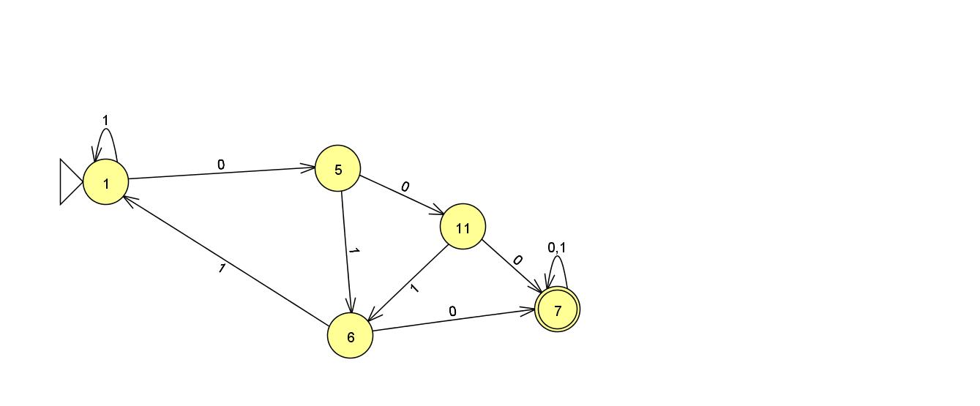
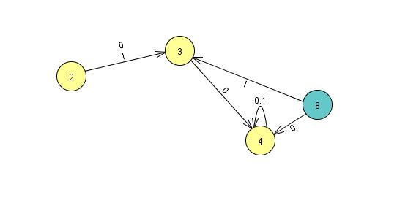
DFA

Slide 23
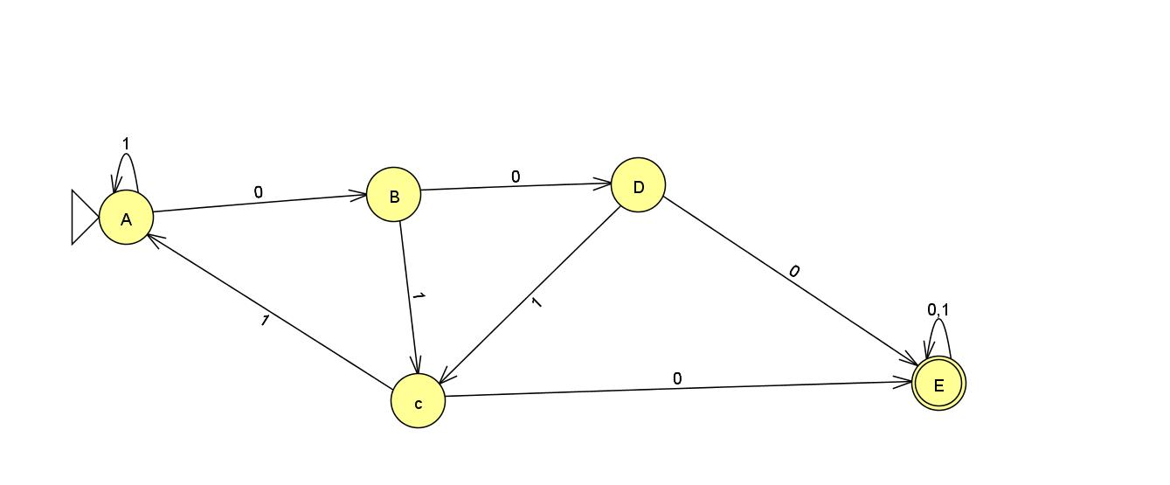
Final DFA

Slide 24
Thanks !!!!
Any Query???

